Slide 1
An Introduction to Contextual Bandits Algorithm
Ph.D. Candidate: Qing Wang
Florida International University

Slide 2
Outline
Introduction
Motivation
Contextual-free Bandit Algorithms
Contextual Bandit Algorithms
Our Work
Ensemble Contextual Bandits for Personalized Recommendation
Personalized Recommendation via Parameter-Free Contextual Bandits
Future Work
Q&A

Slide 3


















What is Personalized Recommendation?
Personalized Recommendation help users find interesting items based the individual interest of each item.
Ultimate Goal: maximize user engagement.
Notes:
Personalized Recommendation is a machine learning based technique to select a subset of items that can maximize the user’s engagement based on individual user’s interests and preference. The ultimate goal is to maximize the user engagement. Currently, only online products deployed this technique to improve their online user engagement.

Slide 4
What is Cold Start Problem?
Do not have enough observations for new items or new users.
How to predict the preference of users if we do not have data?
Many practical issues for offline data
Historical user log data is biased.
User interest may change over time.
Notes:
Cold start problem is a very common problem for personalized recommendation algorithms. For example, for new users or new items, we do not have any historical observation, we cannot predict the user preference for those new users or new items.
Beside new items and new users, cold start problem also exists even if we have the enough data, but the data is biased or out-dated.

Slide 5
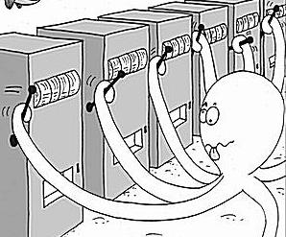
Approach: Multi-armed Bandit Algorithm
A gambler walks into a casino
A row of slot machines providing a random rewards
Objective: Maximize the sum of rewards(Money)!
Notes:
Generally, there are two types of approaches to solve the cold start problem.
The first one is the feature based model. It predicts the user preference based on the content features of the items and users. Some items or users may be new, but the features are not new. So we can do the prediction.
The second approach is called exploration and exploitation. Our work focuses on this type of approach.

Slide 6

Example: News Personalization
Recommend news based on users’ interests.
Goal: Maximize user’s Click-Through-Rate.
[1] Li, Lihong, et al. "A contextual-bandit approach to personalized news article recommendation." Proceedings of the 19th international conference on World wide web. ACM, 2010.
Notes:
Generally, there are two types of approaches to solve the cold start problem.
The first one is the feature based model. It predicts the user preference based on the content features of the items and users. Some items or users may be new, but the features are not new. So we can do the prediction.
The second approach is called exploration and exploitation. Our work focuses on this type of approach.

Slide 7

Example: News Personalization
There are a bunch of articles in the news pool
Users come sequentially and ready to be enter
News articles
[1] Zhou Li, “News personalization with Multi-armed bandits”.
Notes:
Generally, there are two types of approaches to solve the cold start problem.
The first one is the feature based model. It predicts the user preference based on the content features of the items and users. Some items or users may be new, but the features are not new. So we can do the prediction.
The second approach is called exploration and exploitation. Our work focuses on this type of approach.

Slide 8
Example: News Personalization
At each time, we want to select one article for user.
article 1
news articles
Like it?
MABs
Notes:
Generally, there are two types of approaches to solve the cold start problem.
The first one is the feature based model. It predicts the user preference based on the content features of the items and users. Some items or users may be new, but the features are not new. So we can do the prediction.
The second approach is called exploration and exploitation. Our work focuses on this type of approach.

Slide 9

Example: News Personalization
Goal: maximum CTR.
Not really!
article 1
news articles
Like it?
MABs
Notes:
Generally, there are two types of approaches to solve the cold start problem.
The first one is the feature based model. It predicts the user preference based on the content features of the items and users. Some items or users may be new, but the features are not new. So we can do the prediction.
The second approach is called exploration and exploitation. Our work focuses on this type of approach.

Slide 10
Example: News Personalization
Update the model with user’s feedback
Not really!
article 1
news articles
feedback
Like it?
MABs
Notes:
Generally, there are two types of approaches to solve the cold start problem.
The first one is the feature based model. It predicts the user preference based on the content features of the items and users. Some items or users may be new, but the features are not new. So we can do the prediction.
The second approach is called exploration and exploitation. Our work focuses on this type of approach.

Slide 11
Example: News Personalization
Update the model once given the feedback
Yeah!
article 2
news articles
Like it?
MABs
Notes:
Generally, there are two types of approaches to solve the cold start problem.
The first one is the feature based model. It predicts the user preference based on the content features of the items and users. Some items or users may be new, but the features are not new. So we can do the prediction.
The second approach is called exploration and exploitation. Our work focuses on this type of approach.

Slide 12

Example: News Personalization
Update the model once given the feedback
Yeah!
article 2
news articles
feedback
Like it?
How about article 3,4,5…?
MABs
Notes:
Generally, there are two types of approaches to solve the cold start problem.
The first one is the feature based model. It predicts the user preference based on the content features of the items and users. Some items or users may be new, but the features are not new. So we can do the prediction.
The second approach is called exploration and exploitation. Our work focuses on this type of approach.

Slide 13
Multi-armed Bandit Definition
The MAB problem is a classical paradigm in Machine Learning in which an online algorithm choses from a set of strategies in a sequence of trials so as to maximize the total payoff of the chosen strategies.[1]
[1] http://research.microsoft.com/en-us/projects/bandits/
Notes:
Generally, there are two types of approaches to solve the cold start problem.
The first one is the feature based model. It predicts the user preference based on the content features of the items and users. Some items or users may be new, but the features are not new. So we can do the prediction.
The second approach is called exploration and exploitation. Our work focuses on this type of approach.

Slide 14

Application: Clinical Trial
Two treatments with unknown effectiveness
[1] Einstein, A., B. Podolsky, and N. Rosen, 1935, “Can quantum-mechanical description of physical reality be considered complete?”, Phys. Rev. 47, 777-780
Notes:
Generally, there are two types of approaches to solve the cold start problem.
The first one is the feature based model. It predicts the user preference based on the content features of the items and users. Some items or users may be new, but the features are not new. So we can do the prediction.
The second approach is called exploration and exploitation. Our work focuses on this type of approach.

Slide 15
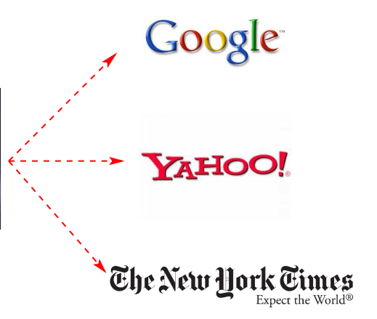
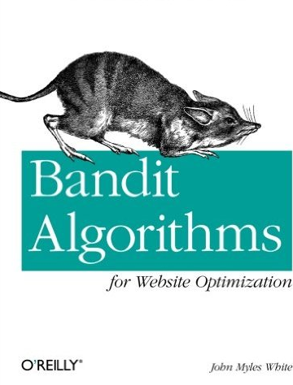
Web advertising
Where to place the ad?
[1] Tang L, Rosales R, Singh A, et al. Automatic ad format selection via contextual bandits[C], Proceedings of the 22nd ACM international conference on Conference on information & knowledge management. ACM, 2013: 1587-1594.
Notes:
Generally, there are two types of approaches to solve the cold start problem.
The first one is the feature based model. It predicts the user preference based on the content features of the items and users. Some items or users may be new, but the features are not new. So we can do the prediction.
The second approach is called exploration and exploitation. Our work focuses on this type of approach.

Slide 16
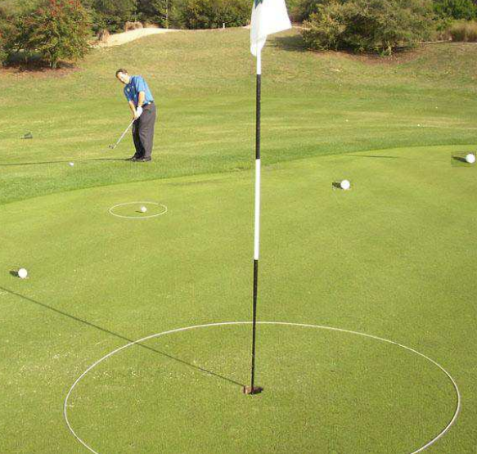
Playing Golf with multi-balls
[1] Dumitriu, Ioana, Prasad Tetali, and Peter Winkler. "On playing golf with two balls." SIAM Journal on Discrete Mathematics 16.4 (2003): 604-615.
Notes:
Generally, there are two types of approaches to solve the cold start problem.
The first one is the feature based model. It predicts the user preference based on the content features of the items and users. Some items or users may be new, but the features are not new. So we can do the prediction.
The second approach is called exploration and exploitation. Our work focuses on this type of approach.

Slide 17
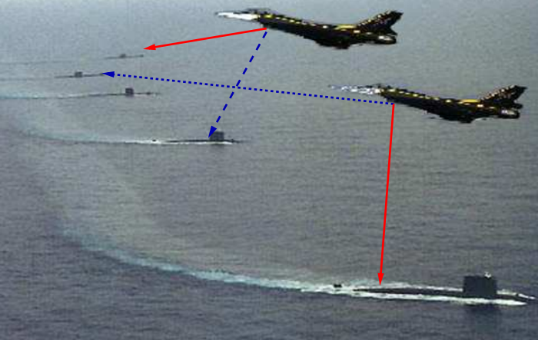
Multi-Agent System
K agents tracking N (N > K) targets:
[1] Ny, Jerome Le, Munther Dahleh, and Eric Feron. "Multi-agent task assignment in the bandit framework." Decision and Control, 2006 45th IEEE Conference on. IEEE, 2006.
Notes:
Generally, there are two types of approaches to solve the cold start problem.
The first one is the feature based model. It predicts the user preference based on the content features of the items and users. Some items or users may be new, but the features are not new. So we can do the prediction.
The second approach is called exploration and exploitation. Our work focuses on this type of approach.

Slide 18
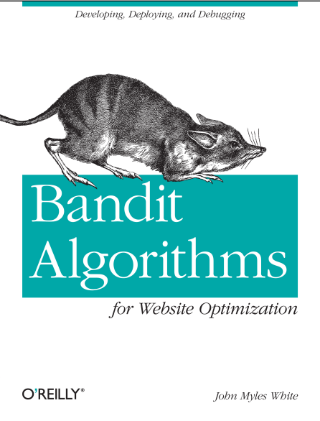
Some Jargon Terms[1]
Arm: one idea/strategy
Bandit: A group of ideas(strategies)
Pull/Play/Trial: One chance to try your strategy
Reward: The unit of success we measure after each pull
Regret: Performance Metric
[1] Bandit Algorithms for Website Optimization Developing, Deploying, and Debugging By John Myles White, O'Reilly Media,2012
Notes:
Generally, there are two types of approaches to solve the cold start problem.
The first one is the feature based model. It predicts the user preference based on the content features of the items and users. Some items or users may be new, but the features are not new. So we can do the prediction.
The second approach is called exploration and exploitation. Our work focuses on this type of approach.

Slide 19
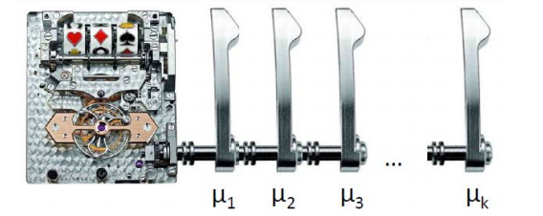
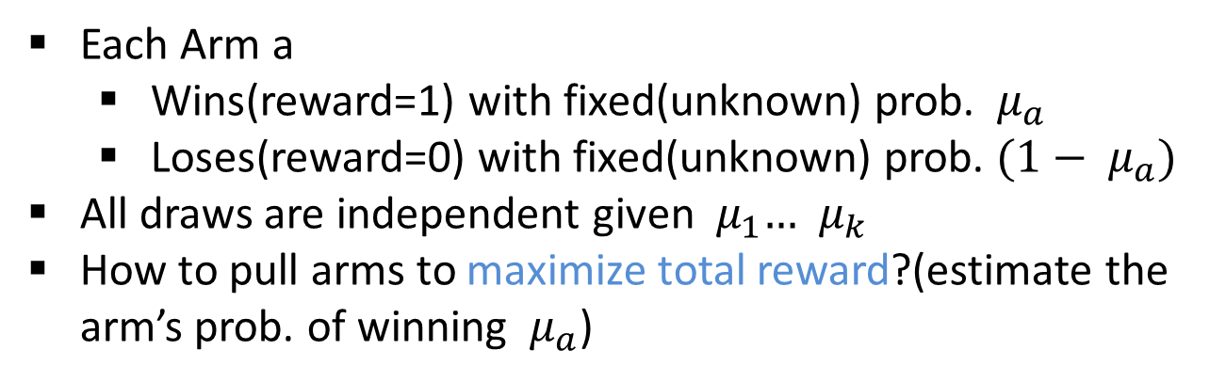
K-Armed Bandit
Each Arm a
Wins(reward=1) with fixed(unknown) prob. ${ μ}_{a}$
Loses(reward=0) with fixed(unknown) prob. ${(1− μ}_{a})$
All draws are independent given ${ μ}_{1}… { μ}_{k}$
How to pull arms to maximize total reward?(estimate the arm’s prob. of winning ${ μ}_{a}$)
[1] CS246 Mining Massive Data Sets 2015, Stanford University
Notes:
Generally, there are two types of approaches to solve the cold start problem.
The first one is the feature based model. It predicts the user preference based on the content features of the items and users. Some items or users may be new, but the features are not new. So we can do the prediction.
The second approach is called exploration and exploitation. Our work focuses on this type of approach.

Slide 20
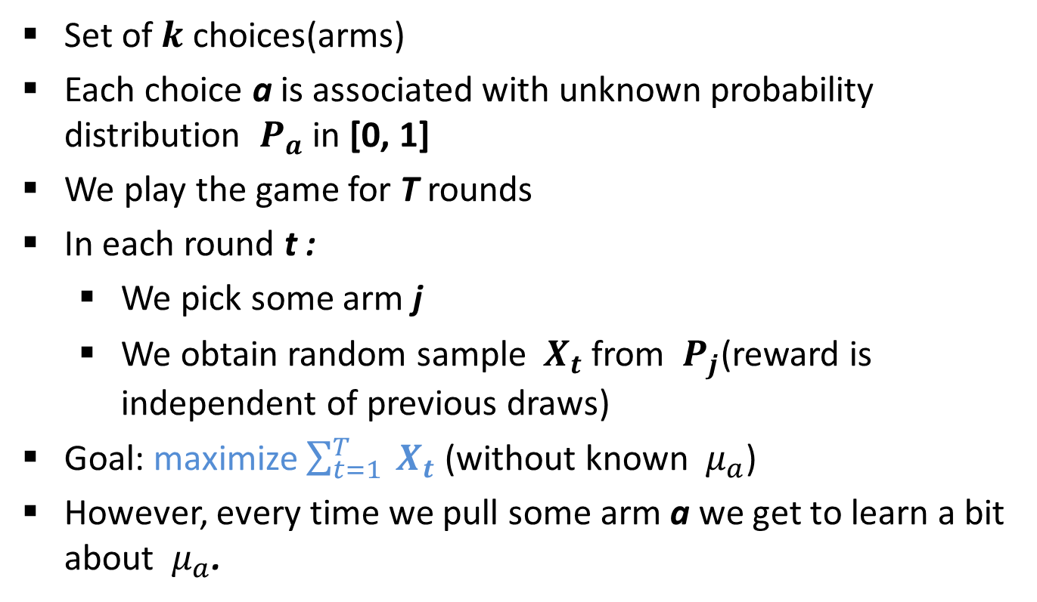
Model of K-Armed Bandit
Set of $k$ choices(arms)
Each choice a is associated with unknown probability distribution ${ P}_{a}$ in [0, 1]
We play the game for T rounds
In each round t :
We pick some arm j
We obtain random sample ${ X}_{t}$ from ${ P}_{j}$(reward is independent of previous draws)
Goal: maximize $\sum_{t=1}^{T}{{ X}_{t}}$ (without known ${ μ}_{a}$)
However, every time we pull some arm a we get to learn a bit about ${ μ}_{a}$.
[1] CS246 Mining Massive Data Sets 2015, Stanford University
Notes:
Generally, there are two types of approaches to solve the cold start problem.
The first one is the feature based model. It predicts the user preference based on the content features of the items and users. Some items or users may be new, but the features are not new. So we can do the prediction.
The second approach is called exploration and exploitation. Our work focuses on this type of approach.

Slide 21
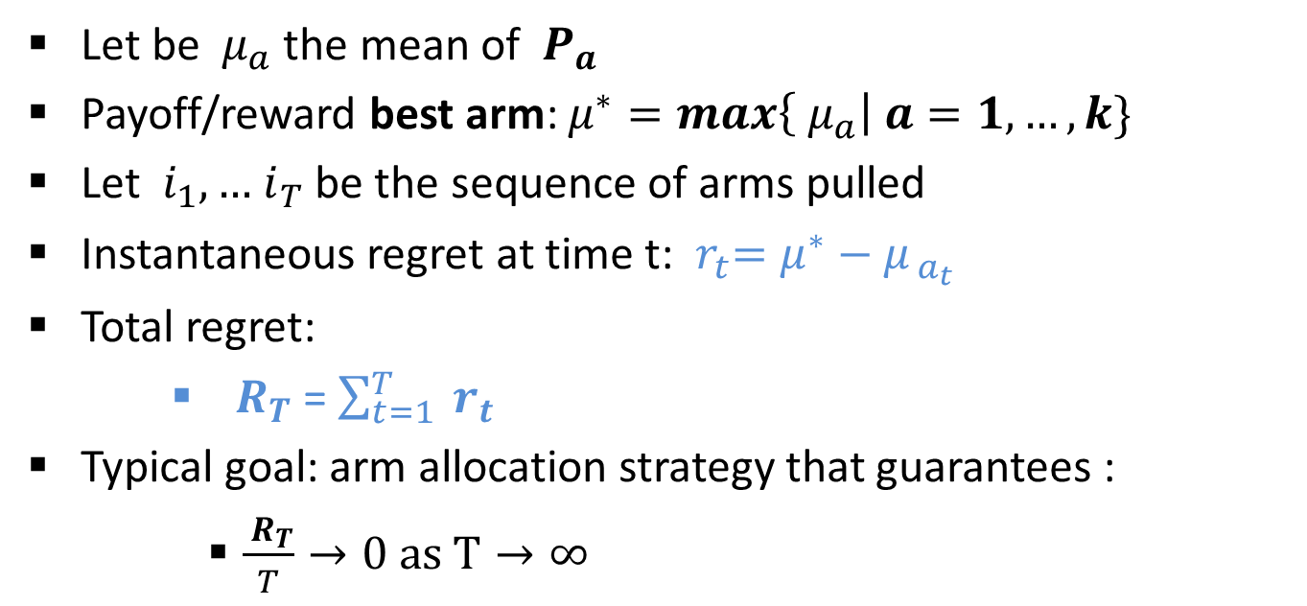
Performance Metric: Regret
Let be ${ μ}_{a}$ the mean of ${ P}_{a}$
Payoff/reward best arm: $μ^{∗}=max\left\{{ μ}_{a}\right| a=1, …,k\}$
Let ${ i}_{1}, …{ i}_{T}$ be the sequence of arms pulled
Instantaneous regret at time t: ${ r}_{t}=μ^{∗}−{ μ}_{{ a}_{t}}$
Total regret:
${ R}_{T}$ = $\sum_{t=1}^{T}{{ r}_{t}}$
Typical goal: arm allocation strategy that guarantees :
$\frac{{ R}_{T}}{T}→0 as T→∞$
[1] CS246 Mining Massive Data Sets 2015, Stanford University
Notes:
Generally, there are two types of approaches to solve the cold start problem.
The first one is the feature based model. It predicts the user preference based on the content features of the items and users. Some items or users may be new, but the features are not new. So we can do the prediction.
The second approach is called exploration and exploitation. Our work focuses on this type of approach.

Slide 22
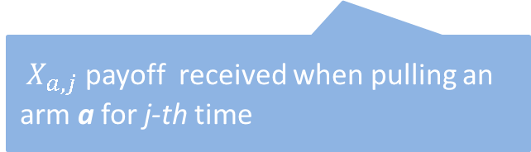
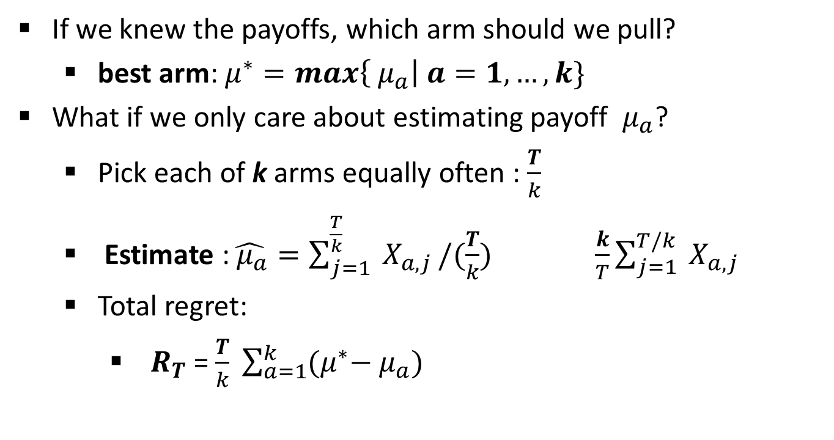
Allocation Strategies
If we knew the payoffs, which arm should we pull?
best arm: $μ^{∗}=max\left\{{ μ}_{a}\right| a=1, …,k\}$
What if we only care about estimating payoff ${ μ}_{a}$?
Pick each of k arms equally often : $\frac{T}{k}$
Estimate :$\hat{{ μ}_{a}}=\sum_{j=1}^{\frac{T}{k}}{{ X}_{a,j}}/(\frac{T}{k})$ $\frac{k}{T}\sum_{j=1}^{T/k}{{ X}_{a,j}}$
Total regret:
${ R}_{T}$ = $\frac{T}{k} \sum_{a=1}^{k}{(μ^{∗}−{ μ}_{a}) }$
[1] CS246 Mining Massive Data Sets 2015, Stanford University
Notes:
Generally, there are two types of approaches to solve the cold start problem.
The first one is the feature based model. It predicts the user preference based on the content features of the items and users. Some items or users may be new, but the features are not new. So we can do the prediction.
The second approach is called exploration and exploitation. Our work focuses on this type of approach.

Slide 23

Exploitation vs Exploration
Tradeoff:
Only exploitation(making decisions based on history data), you will have bad estimation for “best” items.
Only exploration(gathering data about arm payoffs), you will have low user’s engagement.
Notes:
The exploitation is to exploit the user engagement or maximize the number of clicks as many as possible. The exploration is to explore the user’s preference on those items. Basically, the two goals are highly correlated. Because if you have to explore the user’s preference, then you can estimate which item is the best item that can give you the highest click-through rate. But if you do too much exploration, you never do the exploitation, your user’s engagement will suffer a lot. Therefore, the problem of exploration and exploitation is to find the tradeoff.

Slide 24
Algorithm to Exploration & Exploitation
Exploration
tradeoff
Exploitation
K bandit algorithm
Contextual free
Contextual
Epsilon algorithm[1]
UCB1[2]
Ex3, Ex4
Tompson Sampling[3]
LinUCB[4]
[1] Wynn P. On the convergence and stability of the epsilon algorithm[J]. SIAM Journal on Numerical Analysis, 1966, 3(1): 91-122.
[2] Auer P, Cesa-Bianchi N, Fischer P. Finite-time analysis of the multi-armed bandit problem[J]. Machine learning, 2002, 47(2-3): 235-256.
[3] Agrawal S, Goyal N. Analysis of Thompson sampling for the multi-armed bandit problem[J]. arXiv preprint arXiv:1111.1797, 2011.
[4] Li, Lihong, et al. "A contextual-bandit approach to personalized news article recommendation." Proceedings of the 19th international conference on World wide web. ACM, 2010.
Notes:
The exploitation is to exploit the user engagement or maximize the number of clicks as many as possible. The exploration is to explore the user’s preference on those items. Basically, the two goals are highly correlated. Because if you have to explore the user’s preference, then you can estimate which item is the best item that can give you the highest click-through rate. But if you do too much exploration, you never do the exploitation, your user’s engagement will suffer a lot. Therefore, the problem of exploration and exploitation is to find the tradeoff.

Slide 25
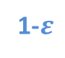
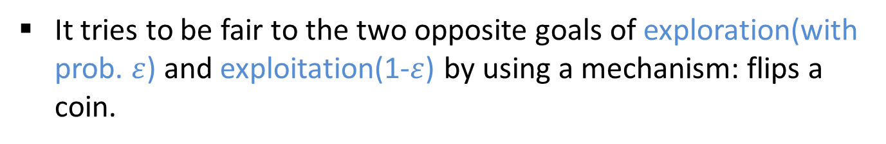

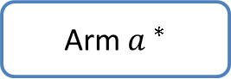

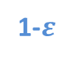



𝜀-Greedy Algorithm
It tries to be fair to the two opposite goals of exploration(with prob. $ε$) and exploitation(1-$ε$) by using a mechanism: flips a coin.
1/k
$ε$/k
Exploration
Arm $a$
Round t
$$ε$$
1/k
$ε$/k
Arm $b$
1-$ε$
1-$ε$
Exploitation
(choose best arm)
Arm ${a }^{∗}$

Slide 26
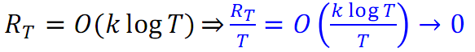
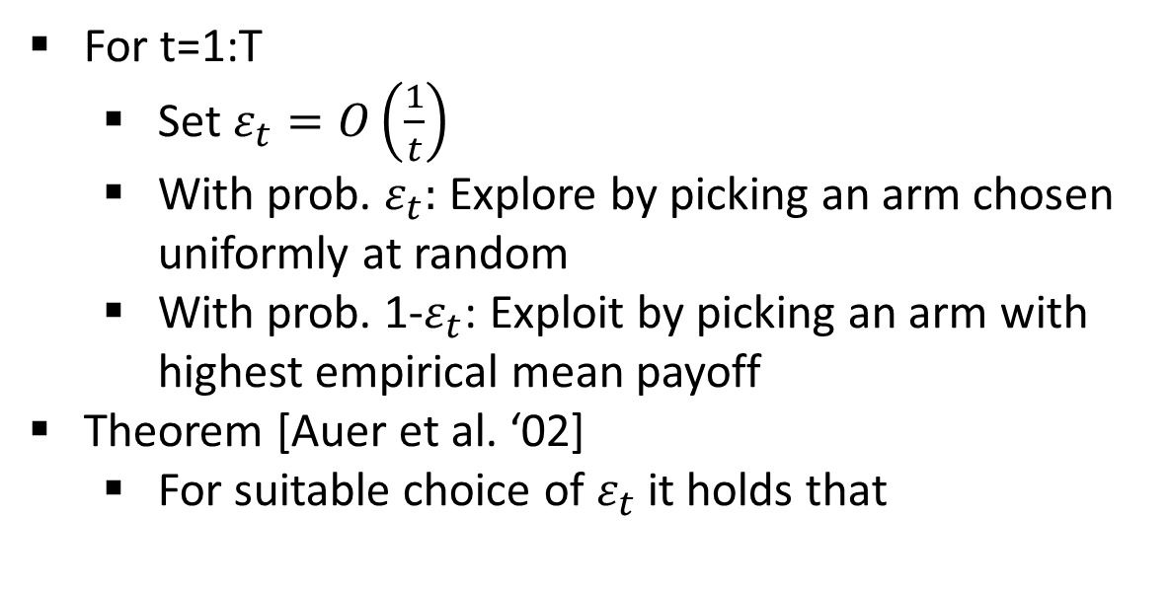
𝜀-Greedy Algorithm
For t=1:T
Set $ε_{t}=O\left(\frac{1}{t}\right)$
With prob. $ε_{t}:$ Explore by picking an arm chosen uniformly at random
With prob. 1-$ε_{t}$: Exploit by picking an arm with highest empirical mean payoff
Theorem [Auer et al. ‘02]
For suitable choice of $ε_{t}$ it holds that

Slide 27
Issues with 𝜀-Greedy Algorithm
Not elegant” : Algorithm explicitly distinguishes between exploration and exploitation
More importantly: Exploration makes suboptimal choices(since it picks any arm equally likely)
Idea: When exploring/exploiting we need to compare arms.

Slide 28
Example : Comparing Arms
Suppose we have done experiments :
Arm 1: 1 0 0 1 1 1 0 0 0 1
Arm 2: 1
Arm 3: 1 1 0 1 0 0 1 1 1 1
Mean arm values:
Arm 1: 5/10 Arm 2: 1 Arm 3: 7/10
Which arm would you choose next?
Idea: Not only look at the mean but also the confidence!

Slide 29
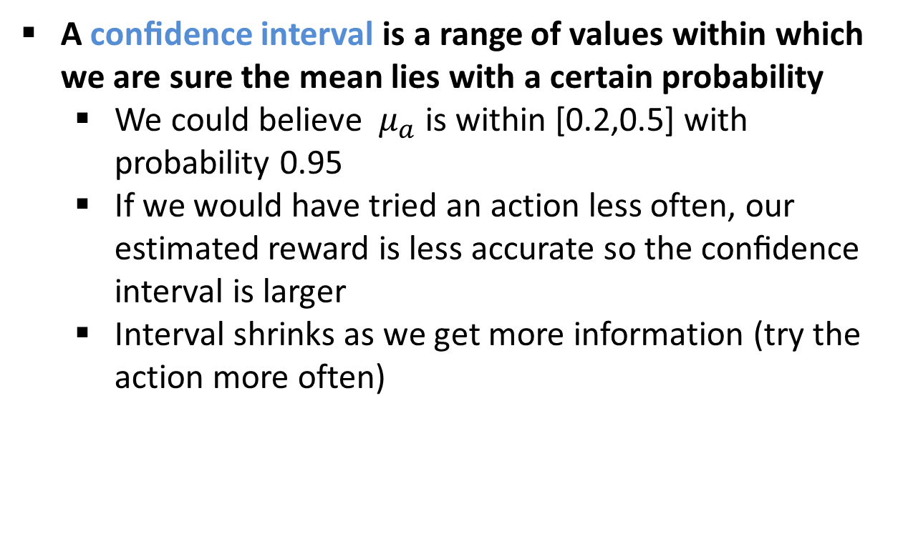
Confidence Intervals
A conﬁdence interval is a range of values within which we are sure the mean lies with a certain probability
We could believe ${ μ}_{a}$ is within [0.2,0.5] with probability 0.95
If we would have tried an action less often, our estimated reward is less accurate so the conﬁdence interval is larger
Interval shrinks as we get more information (try the action more often)

Slide 30
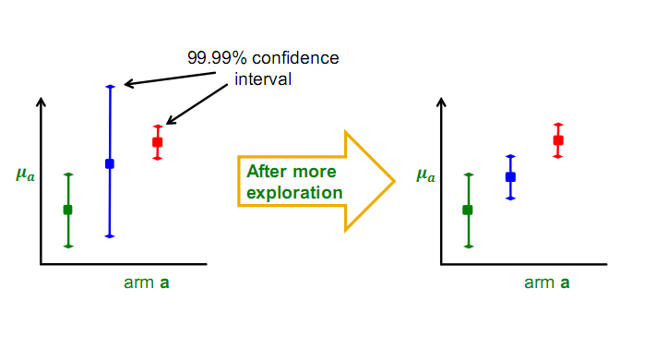
Confidence Based Selection
Assuming we know the confidence intervals
Then, instead of trying the action with the highest mean we can try the action with the highest upper bound on its confidence interval.

Slide 31
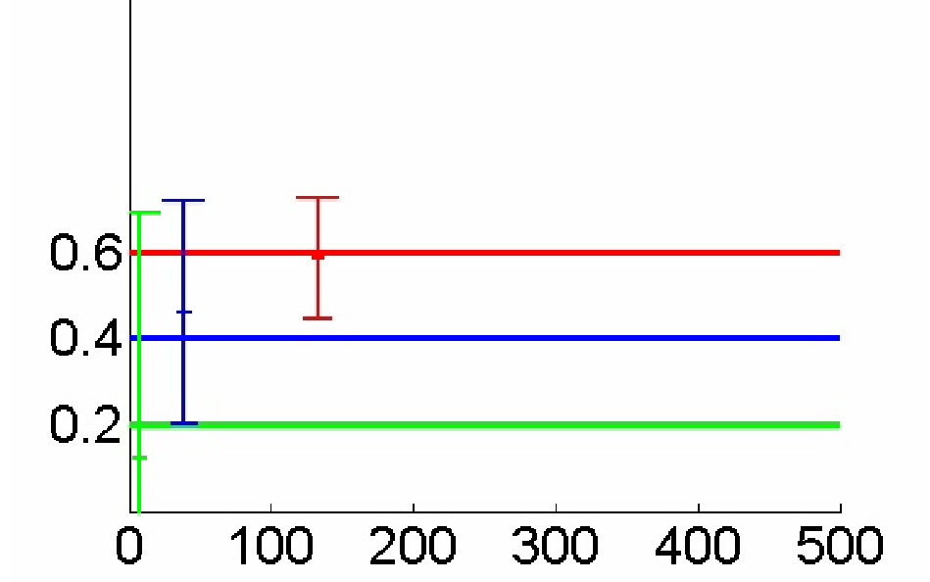
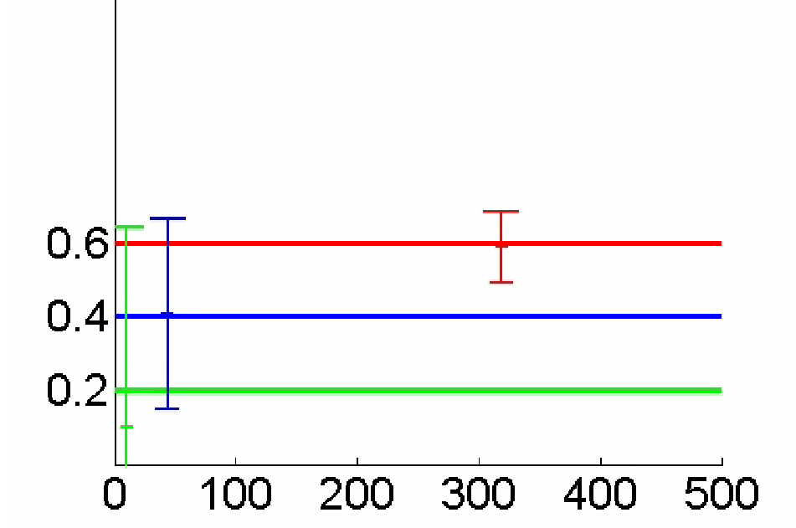
Confidence intervals vs Sampling times
The estimation of confidence becomes smaller as the number of pulling times increases.
[1] Jean-Yves Audibert and Remi Munos, Introduction to Bandits: Algorithms and Theory. ICML 2011, Bellevue(WA), USA

Slide 32
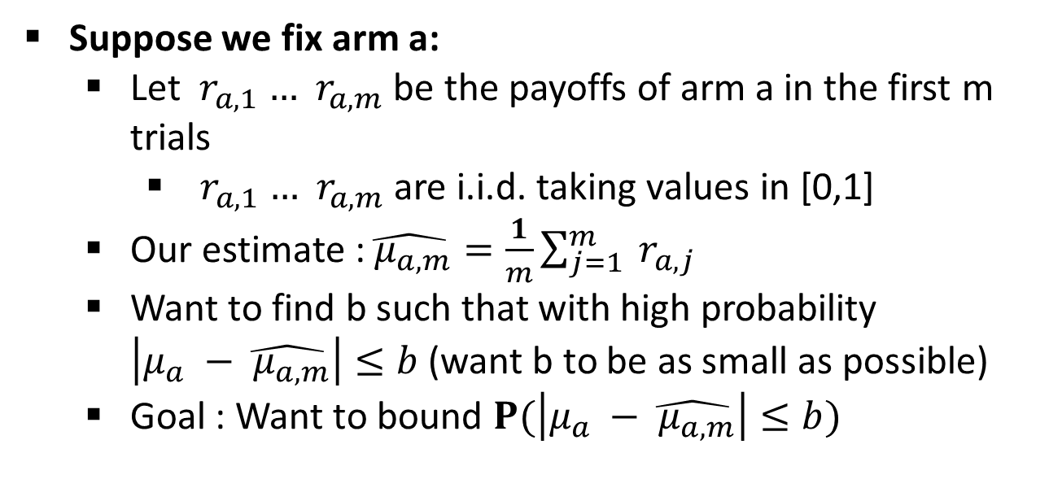
Calculating Confidence Bounds
Suppose we fix arm a:
Let ${ r}_{a,1} …$ ${ r}_{a,m}$ be the payoffs of arm a in the first m trials
${ r}_{a,1} …$ ${ r}_{a,m}$ are i.i.d. taking values in [0,1]
Our estimate :$\hat{{ μ}_{a,m}}=\frac{1}{m}\sum_{j=1}^{m}{{ r}_{a,j}}$
Want to find b such that with high probability $\left|μ_{a} −\hat{{ μ}_{a,m}}\right|≤b$ (want b to be as small as possible)
Goal : Want to bound $P(\left|μ_{a} −\hat{{ μ}_{a,m}}\right|≤b)$

Slide 33
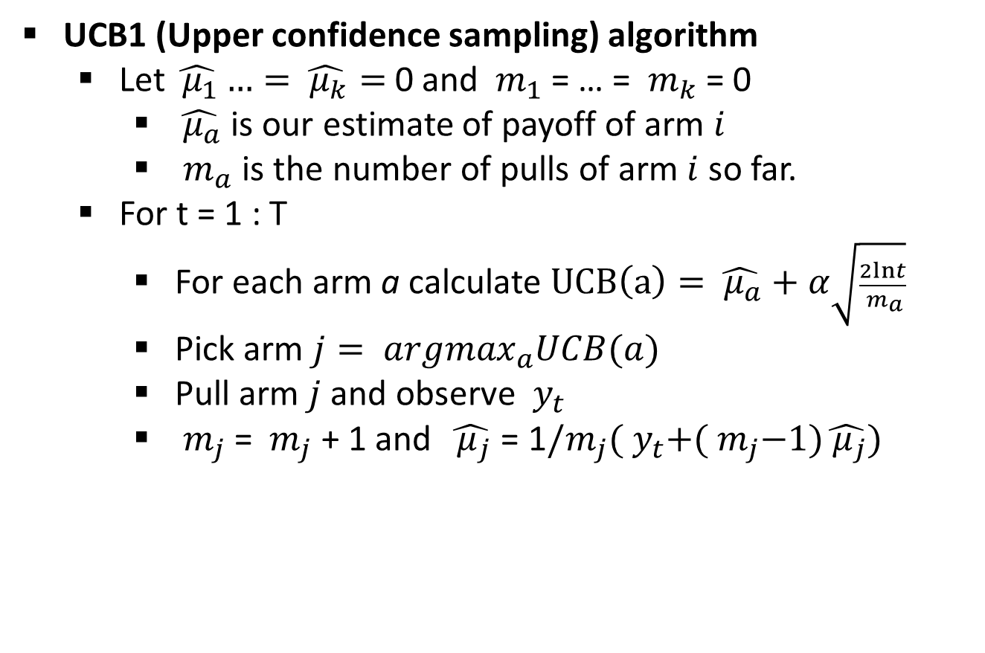
UCB1 Algorithm
UCB1 (Upper confidence sampling) algorithm
Let $\hat{{ μ}_{1}}…=\hat{{ μ}_{k}}=$ 0 and ${ m}_{1}$ = … = ${ m}_{k}$ = 0
$\hat{{ μ}_{a}}$ is our estimate of payoff of arm $i$
${ m}_{a}$ is the number of pulls of arm $i$ so far.
For t = 1 : T
For each arm a calculate $UCB\left(a\right)=\hat{{ μ}_{a}}+α\sqrt{\frac{2lnt}{{ m}_{a}}}$
Pick arm $j= {argmax}_{a}UCB(a)$
Pull arm $j$ and observe ${ y}_{t}$
${ m}_{j}$ = ${ m}_{j}$ + 1 and $\hat{{ μ}_{j}}$ = 1$/m_{j}({ y}_{t}+({ m}_{j}−1)\hat{{ μ}_{j}})$
Hoeffding’s Inequality

Slide 34
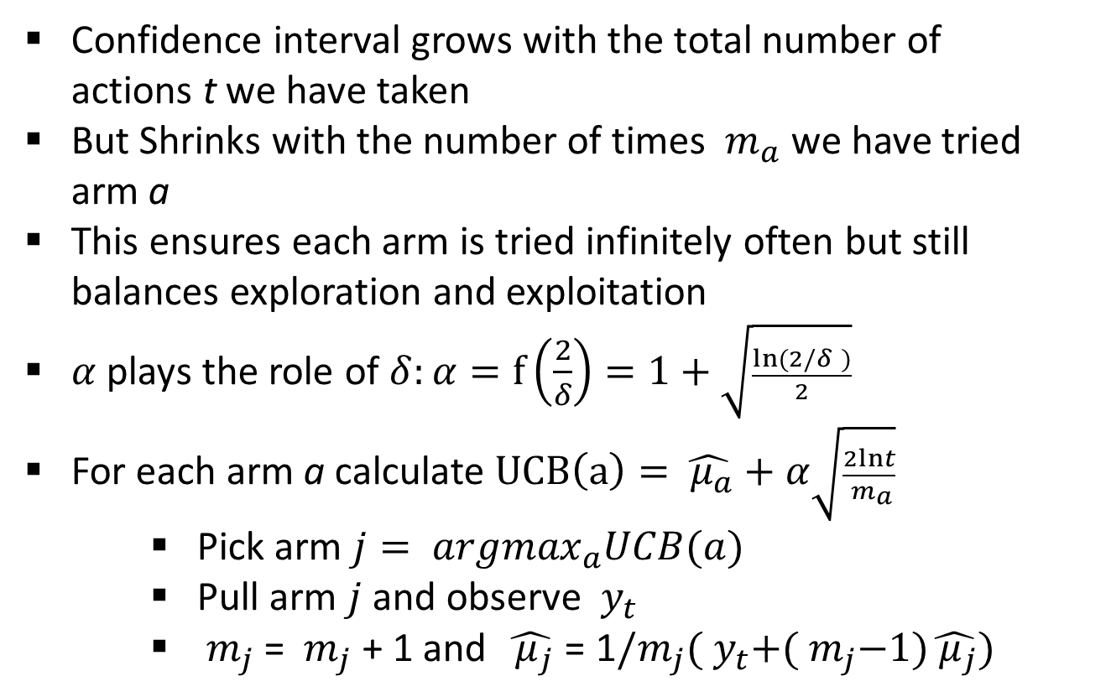
UCB1 Algorithm: Discussion
Confidence interval grows with the total number of actions t we have taken
But Shrinks with the number of times ${ m}_{a}$ we have tried arm a
This ensures each arm is tried infinitely often but still balances exploration and exploitation
$α$ plays the role of $δ:α=f\left(\frac{2}{δ}\right)=1+\sqrt{\frac{ln⁡(2/δ )}{2}}$
For each arm a calculate $UCB\left(a\right)=\hat{{ μ}_{a}}+α\sqrt{\frac{2lnt}{{ m}_{a}}}$
Pick arm $j= {argmax}_{a}UCB(a)$
Pull arm $j$ and observe ${ y}_{t}$
${ m}_{j}$ = ${ m}_{j}$ + 1 and $\hat{{ μ}_{j}}$ = 1$/m_{j}({ y}_{t}+({ m}_{j}−1)\hat{{ μ}_{j}})$

Slide 35
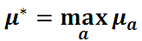
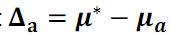
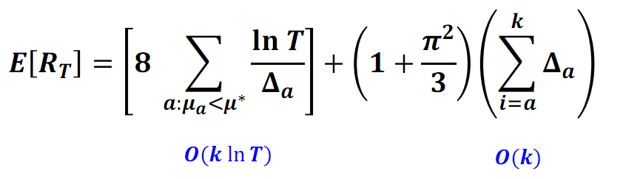
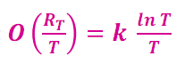
UCB1 Algorithm Performance
Theorem [Auer et al. 2002]
Suppose optimal mean payoff is
And for each arm let
Then it holds that
So, we get

Slide 36
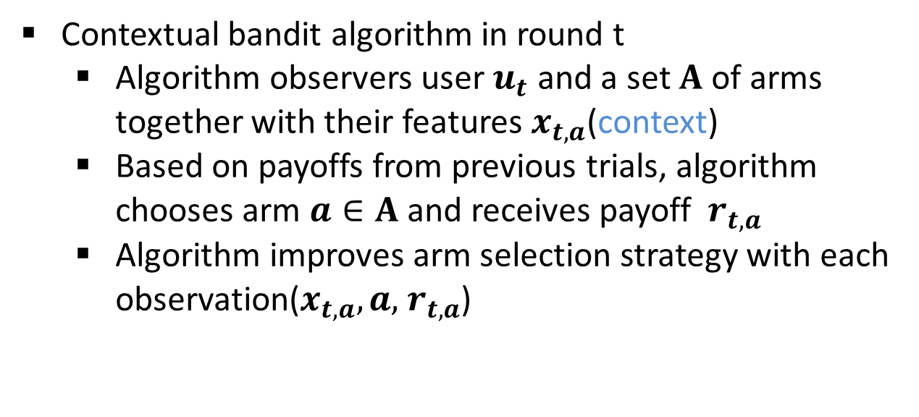
Contextual Bandits
Contextual bandit algorithm in round t
Algorithm observers user $u_{t}$ and a set $A$ of arms together with their features $x_{t,a}$(context)
Based on payoffs from previous trials, algorithm chooses arm $a∈A$ and receives payoff ${ r}_{t,a}$
Algorithm improves arm selection strategy with each observation($x_{t,a},a,{ r}_{t,a}$)

Slide 37
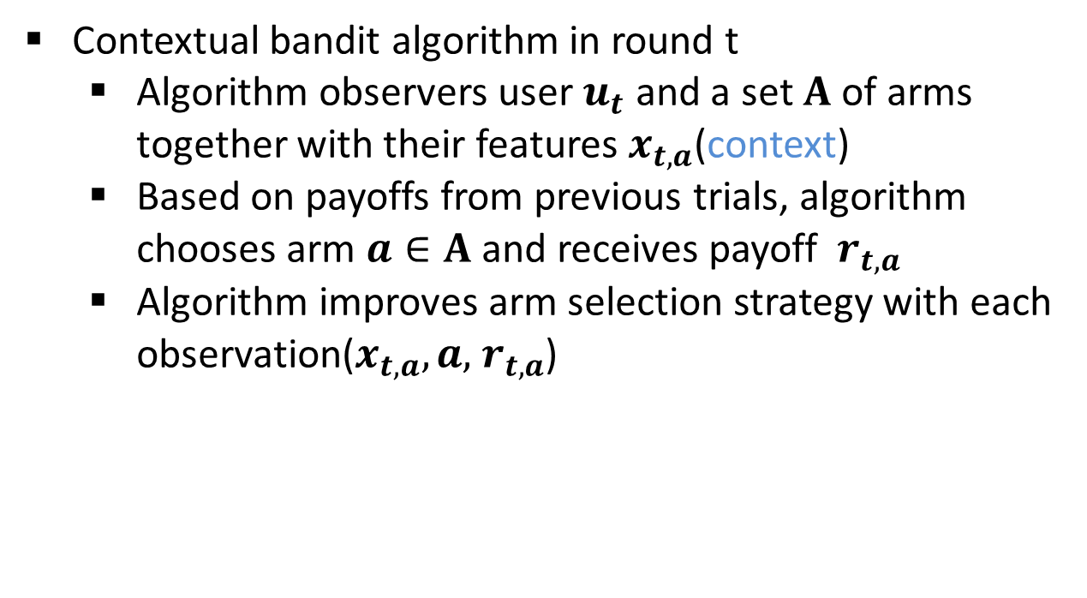
LinUCB Algorithm[1]
Contextual bandit algorithm in round t
Algorithm observers user $u_{t}$ and a set $A$ of arms together with their features $x_{t,a}$(context)
Based on payoffs from previous trials, algorithm chooses arm $a∈A$ and receives payoff ${ r}_{t,a}$
Algorithm improves arm selection strategy with each observation($x_{t,a},a,{ r}_{t,a}$)
[1] Li, Lihong, et al. "A contextual-bandit approach to personalized news article recommendation." Proceedings of the 19th international conference on World wide web. ACM, 2010.

Slide 38
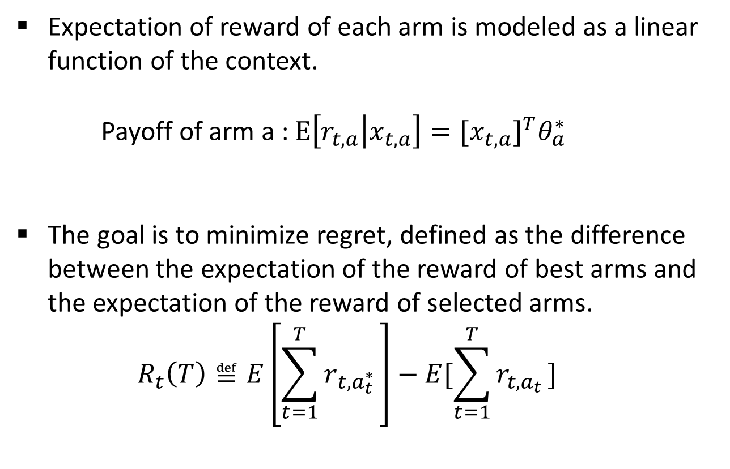
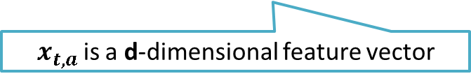
LinUCB Algorithm
Expectation of reward of each arm is modeled as a linear function of the context.
Payoff of arm a : $E\left[r_{t,a} | x_{t,a}\right]={{[x}_{t,a}]}^{T}θ_{a}^{∗}$
The goal is to minimize regret, defined as the difference between the expectation of the reward of best arms and the expectation of the reward of selected arms.
$$R_{t}\left(T\right)≝E\left[\sum_{t=1}^{T}{r_{t,a_{t}^{∗} }}\right]−E[\sum_{t=1}^{T}{r_{t,a_{t} }}]$$
$θ_{a}^{∗}$is the unknown coefficient vector we aim to learn
$x_{t,a}$ is a d-dimensional feature vector

Slide 39
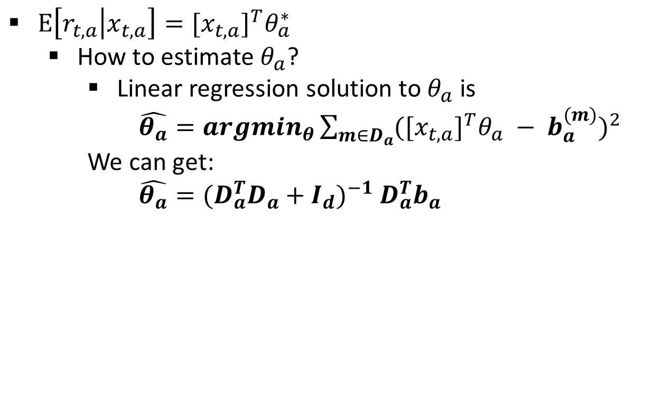
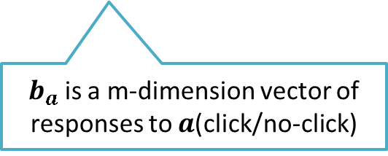
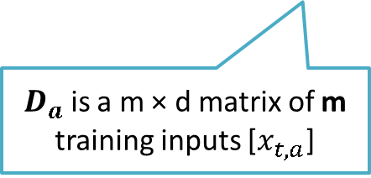
LinUCB Algorithm
$E\left[r_{t,a} | x_{t,a}\right]={{[x}_{t,a}]}^{T}θ_{a}^{∗}$
How to estimate $θ_{a}$?
Linear regression solution to $θ_{a}$ is
$\hat{θ_{a}}=arg\min_{θ}\sum_{m∈D_{a}}{{({{[x}_{t,a}]}^{T}θ_{a} − b_{a}^{(m)})}^{2}}$
We can get:
$\hat{θ_{a}}={(D_{a}^{T}D_{a}+I_{d})}^{−1}$ $D_{a}^{T}b_{a}$
$D_{a}$ is a m × d matrix of m training inputs [$x_{t,a}$]
$b_{a}$ is a m-dimension vector of responses to $a$(click/no-click)

Slide 40
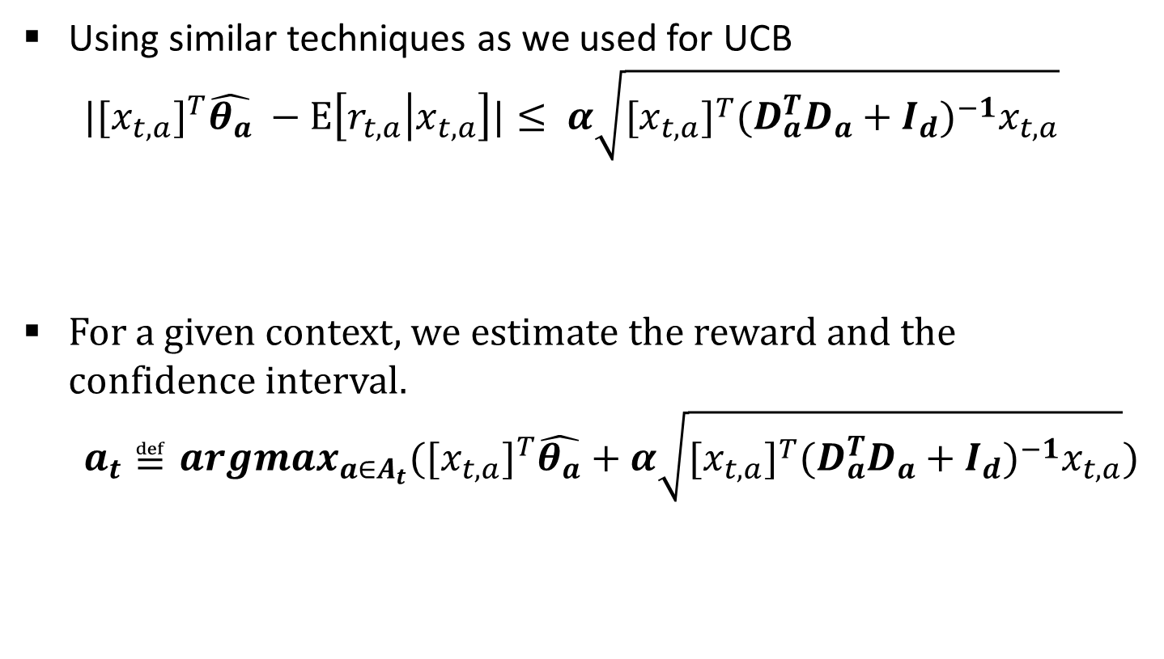
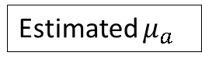
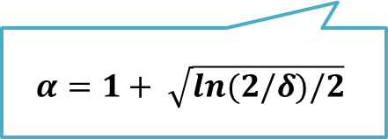
LinUCB Algorithm
Using similar techniques as we used for UCB
$${{|[x}_{t,a}]}^{T}\hat{θ_{a}} −E\left[r_{t,a} | x_{t,a}\right]|≤ α\sqrt{{{[x}_{t,a}]}^{T}{(D_{a}^{T}D_{a}+I_{d})}^{−1}x_{t,a}}$$
For a given context, we estimate the reward and the confidence interval.
$a_{t}≝arg\max_{a∈A_{t}}({{[x}_{t,a}]}^{T}\hat{θ_{a}}+α\sqrt{{{[x}_{t,a}]}^{T}{(D_{a}^{T}D_{a}+I_{d})}^{−1}x_{t,a}})$
$$α=1+ \sqrt{ln(2/δ)/2}$$
Estimated $μ_{a}$
Confidence interval

Slide 41
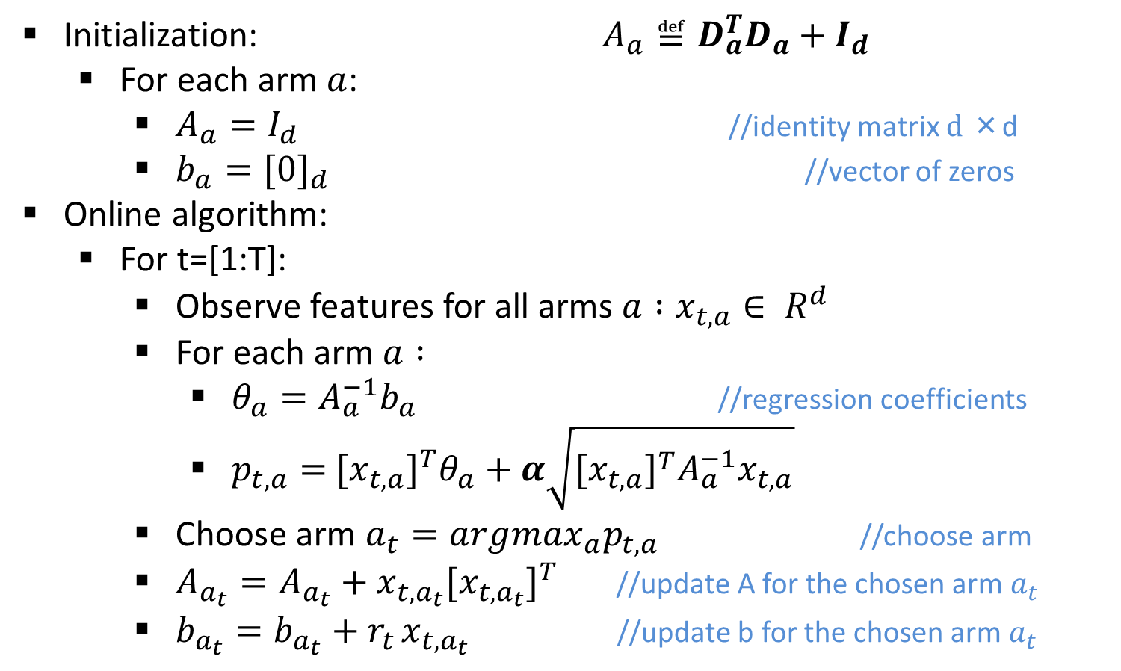
LinUCB Algorithm
Initialization: $A_{a}≝D_{a}^{T}D_{a}+I_{d}$
For each arm $a$:
$A_{a}=I_{d}$ //identity matrix $\text{d}\text{ ×}\text{d}$
$b_{a}={[0]}_{d}$ //vector of zeros
Online algorithm:
For t=[1:T]:
Observe features for all arms $a :x_{t,a}∈ R^{d}$
For each arm $a :$
$θ_{a}=A_{a}^{−1}b_{a}$ //regression coefficients
$p_{t,a}=$ ${{[x}_{t,a}]}^{T}θ_{a}+α\sqrt{{{[x}_{t,a}]}^{T}A_{a}^{−1}x_{t,a}}$
Choose arm $a_{t}=arg\max_{a}p_{t,a}$ //choose arm
$A_{a_{t}}=A_{a_{t}}+x_{t,a_{t}}{{[x}_{t,a_{t}}]}^{T}$ //update A for the chosen arm $a_{t}$
$b_{a_{t}}=b_{a_{t}}+r_{t }x_{t,a_{t}}$ //update b for the chosen arm $a_{t}$

Slide 42
LinUCB: Discussion
LinUCB computational complexity is
Linear in the number of arms and
At most cubic in the number of features
LinUCB works well for a dynamic arm set(arms com and go)
For example, in news article recommendation, for instance, editors add/remove articles to/from a pool

Slide 43
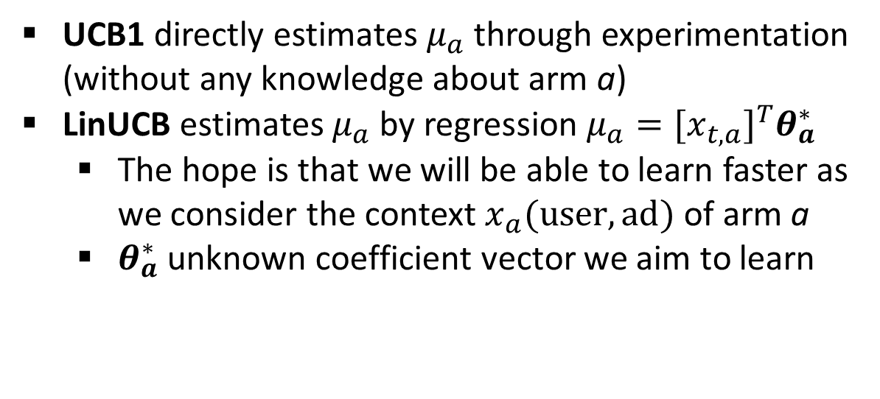
Different between UCB1
and LinUCB
UCB1 directly estimates $μ_{a}$ through experimentation (without any knowledge about arm a)
LinUCB estimates $μ_{a}$ by regression $μ_{a}={{[x}_{t,a}]}^{T}θ_{a}^{∗}$
The hope is that we will be able to learn faster as we consider the context $x_{a}(user, ad)$ of arm a
$θ_{a}^{∗}$ unknown coefficient vector we aim to learn

Slide 44
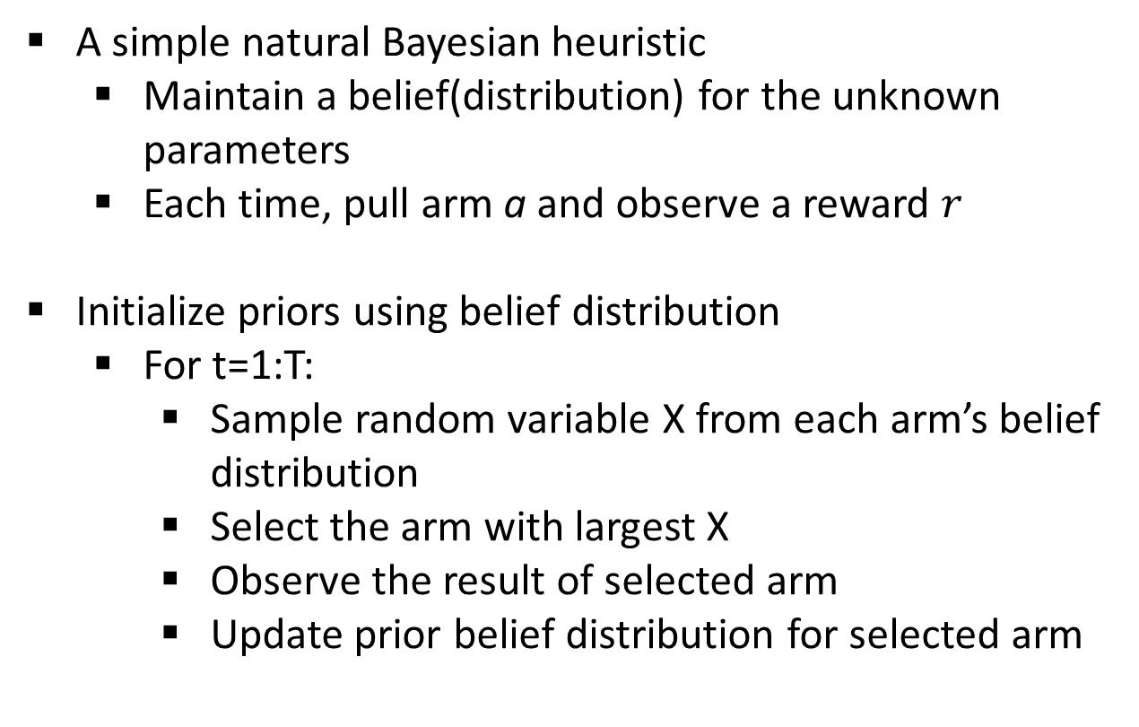
Thompson Sampling
A simple natural Bayesian heuristic
Maintain a belief(distribution) for the unknown parameters
Each time, pull arm a and observe a reward $r$
Initialize priors using belief distribution
For t=1:T:
Sample random variable X from each arm’s belief distribution
Select the arm with largest X
Observe the result of selected arm
Update prior belief distribution for selected arm
[1] Agrawal S, Goyal N. Analysis of Thompson sampling for the multi-armed bandit problem[J]. arXiv preprint arXiv:1111.1797, 2011.

Slide 45
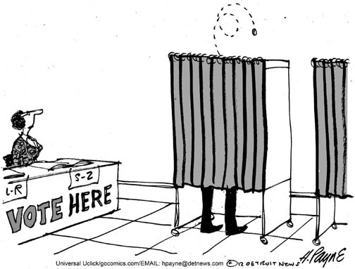
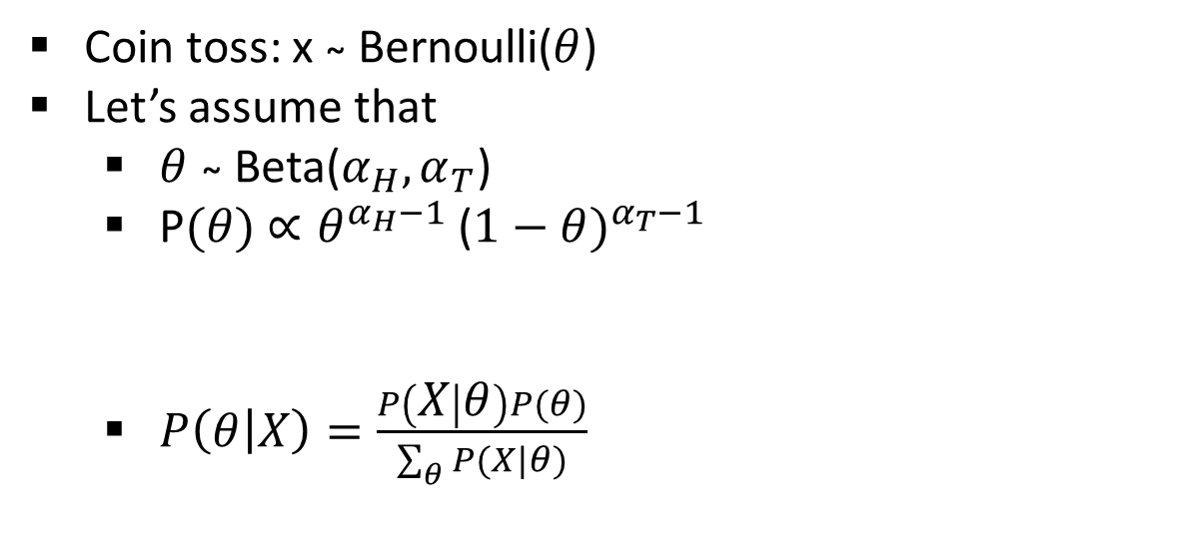
Simple Example
Coin toss: x ̴ Bernoulli($θ$)
Let’s assume that
$θ$ ̴ Beta($α_{H}, α_{T}$)
P$(θ)$ $∝θ^{α_{H}−1}$ (${1−θ)}^{α_{T}−1}$
$P\left(θ | X\right)=\frac{P\left(X | θ\right)P(θ)}{\sum_{θ}{P(X|θ)}}$
Beta distribution
Prior
The prior is conjugate!
Posterior

Slide 46
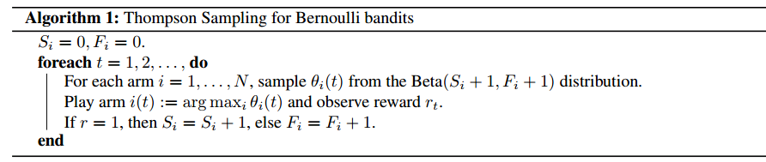
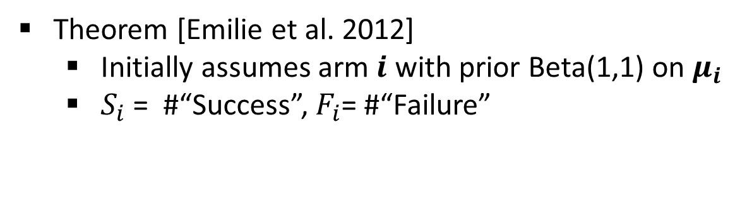
Thompson Sampling
Using Beta belief distribution
Theorem [Emilie et al. 2012]
Initially assumes arm $i$ with prior Beta(1,1) on $μ_{i}$
$S_{i}$ = #“Success”, $F_{i}$= #“Failure”

Slide 47
Thompson Sampling
Using Beta belief distribution
Initialization
Beta(1,1)
Beta(1,1)
Beta(1,1)
Arm 1
Arm 2
Arm 3

Slide 48
Thompson Sampling
Using Beta belief distribution
For each round:
Sample random variable X from each arm’s Beta Distribution
X 0.7 0.2 0.4
Beta(1,1)
Beta(1,1)
Beta(1,1)
Arm 1
Arm 2
Arm 3

Slide 49
Thompson Sampling
Using Beta belief distribution
For each round:
Sample random variable X from each arm’s Beta Distribution
Select the arm with largest X
X 0.7 0.2 0.4
Beta(1,1)
Beta(1,1)
Beta(1,1)
Arm 1
Arm 2
Arm 3

Slide 50
Thompson Sampling
Using Beta belief distribution
For each round:
Sample random variable X from each arm’s Beta Distribution
Select the arm with largest X
Observe the result of selected arm
Success!
X 0.7 0.2 0.4
Beta(1,1)
Beta(1,1)
Beta(1,1)
Arm 1
Arm 2
Arm 3

Slide 51
Thompson Sampling
Using Beta belief distribution
For each round:
Sample random variable X from each arm’s Beta Distribution
Select the arm with largest X
Observe the result of selected arm
Update prior Beta distribution for selected arm
Success!
X 0.7 0.2 0.4
Beta(2,1)
Beta(1,1)
Beta(1,1)
Arm 1
Arm 2
Arm 3

Slide 52
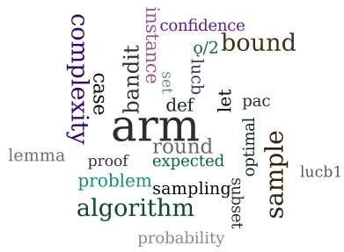
Our Research 1:
Ensemble Contextual Bandits for Personalized Recommendation
[1] Tang, Liang, et al. "Ensemble contextual bandits for personalized recommendation." Proceedings of the 8th ACM Conference on Recommender systems. ACM, 2014.

Slide 53
Problem Statement
Problem Setting: have many different recommendation models (or policies):
Different CTR Prediction Algorithms.
Different Exploration-Exploitation Algorithms.
Different Parameter Choices.
No data to do model validation
Problem Statement: how to build an ensemble model that is close to the best model in the cold start situation ?

Slide 54
How Ensemble?
Classifier ensemble method does not work in this setting
Recommendation decision is NOT purely based on the predicted CTR.
Each individual model only tells us:
Which item to recommend.

Slide 55
Ensemble Method
Our Method:
Allocate recommendation chances to individual models.
Problem:
Better models should have more chances.
We do not know which one is good or bad in advance.
Ideal solution: allocate all chances to the best one.

Slide 56
Current Practice: Online Evaluation (or A/B testing)
Let π₁, π₂ … π_{m} be the individual models.
Deploy π₁, π₂ … π_{m} into the online system at the same time.
Dispatch a small percent user traffic to each model.
After a period, choose the model having the best CTR as the production model.

Slide 57
Current Practice: Online Evaluation (or A/B testing)
Let π₁, π₂ … π_{m} be the individual models.
Deploy π₁, π₂ … π_{m} into the online system at the same time.
Dispatch a small percent user traffic to each model.
After a period, choose the model having the best CTR as the production model.
If we have too many models, this will hurt the performance of the online system.

Slide 58
Our Idea 1 (HyperTS)
The CTR of model π_{i} is a random unknown variable, R_{i} .
Goal:
maximize , r_{t} is a random number drawn from R_{s(t)}, s(t)=1,2,…, or m. For each t=1,…,N, we decide s(t).
Solution:
Bernoulli Thompson Sampling (flat prior: beta(1,1)) .
π₁, π₂ … π_{m} are bandit arms.
CTR of our ensemble model
No tricky parameters

Slide 59
An Example of HyperTS
R₁
R₂
In memory, we keep these estimated CTRs for π₁, π₂ … π_{m.}
…
R_{k}
…
R_{m}

Slide 60
An Example of HyperTS
A user visit
Estimated CTRs
R₁
HyperTS selects a candidate model, π_{k} .
R₂
…
R_{k}
…
R_{m}

Slide 61
An Example of HyperTS
A user visit
Estimated CTRs
R₁
x_{t:}: context
features
HyperTS selects a candidate model, π_{k} .
R₂
…
A
π_{k} recommends item A to the user.
R_{k}
…
R_{m}

Slide 62
An Example of HyperTS
A user visit
Estimated CTRs
R₁
x_{t:}: context
features
HyperTS selects a candidate model, π_{k} .
A
R₂
r_{t} :click or not
…
π_{k} recommends item A to the user.
R_{k}
update
…
HyperTS updates the estimation of R_{k} based on r_{t}.
R_{m}

Slide 63
Two-Layer Decision
Bernoulli Thompson Sampling
π₁
π₂
π_{k}
π_{m}
…
…
Item A
Item B
Item C

Slide 64
Our Idea 2 (HyperTSFB)
Limitation of Previous Idea:
For each recommendation, user feedback is used by only one individual model (e.g., π_{k}).
Motivation:
Can we update all R₁, R₂, …, R_{m} by every user feedback? (Share every user feedback to every individual model).

Slide 65
Our Idea 2 (HyperTSFB)
Assume each model can output the probability of recommending any item given x_{t}.
E.g., for deterministic recommendation, it is 1 or 0.
For a user visit x_{t}:
π_{k} is selected to perform recommendation (k=1,2,…, or m).
Item A is recommended by π_{k} given x_{t}.
Receive a user feedback (click or not click), r_{t.}
Ask every model π₁, π₂ … π_{m}, what is the probability of recommending A given x_{t.}

Slide 66
Our Idea 2 (HyperTSFB)
Assume each model can output the probability of recommending any item given x_{t}.
E.g., for deterministic recommendation, it is 1 or 0.
For a user visit x_{t}:
π_{k} is selected to perform recommendation (k=1,2,…, or m).
Item A is recommended by π_{k} given x_{t}.
Receive a user feedback (click or not click), r_{t.}
Ask every model π₁, π₂ … π_{m}, what is the probability of recommending A given x_{t.}
Estimate the CTR of π₁, π₂ … π_{m} (Importance Sampling)

Slide 67
Experimental Setup
Experimental Data
Yahoo! Today News data logs (randomly displayed).
KDD Cup 2012 Online Advertising data set.
Evaluation Methods
Yahoo! Today News: Replay (see Lihong Li et. al’s WSDM 2011 paper).
KDD Cup 2012 Data: Simulation by a Logistic Regression Model.

Slide 68
Comparative Methods
CTR Prediction Algorithm
Logistic Regression
Exploitation-Exploration Algorithms
Random, ε-greedy, LinUCB, Softmax, Epoch-greedy, Thompson sampling
HyperTS and HyperTSFB

Slide 69
Results for Yahoo! News Data
Every 100,000 impressions are aggregated into a bucket.

Slide 70
Results for Yahoo! News Data (Cont.)

Slide 71
Conclusions
The performance of baseline exploitation-exploration algorithms is very sensitive to the parameter setting.
In cold-start situation, no enough data to tune parameter.
HyperTS and HyperTSFB can be close to the optimal baseline algorithm (No guarantee be better than the optimal one), even though some bad individual models are included.
For contextual Thompson sampling, the performance depends on the choice of prior distribution for the logistic regression.
For online Bayesian learning, the posterior distribution approximation is not accurate(cannot store the past data).

Slide 72

Our Research 2:
Personalized Recommendation via Parameter-Free Contextual Bandits
[1] Tang, Liang, et al. "Personalized recommendation via parameter-free contextual bandits." Proceedings of the 38th International ACM SIGIR Conference on Research and Development in Information Retrieval. ACM, 2015.

Slide 73
How to Balance Tradeoff
Performance is mainly determined by the tradeoff. Existing algorithms find the tradeoff by user input parameters and data characteristics (e.g., variance of the estimated reward).
Existing algorithms are all parameter-sensitive.
Good
algorithm parameter is good
An algorithm
Bad
algorithm parameter is bad
Notes:
How to balance the tradeoff of Exploitation and Exploration is the key for every bandit algorithm.
Almost every existing bandit algorithm can have the best empirical performance if the input parameters are appropriate.
Almost every existing bandit algorithm can have a very bad empirical performance if the input parameters are bad.
For example, for epsilon-greedy algorithm, the tradeoff is totally controlled by the input parameter epsilon. If it is too small, you do not have enough exploration. It it is too large, you will waste too impressions.
For Thompson Sampling, the tradeoff is controlled by the prior and the data distribution. If the prior is not appropriate, you will waste a lot of impression to get the accurate posterior distribution. Then, it would also have the bad performance. How to choose the prior is same as how to those the epsilon in epsilon-greedy algorithm.
Therefore, how to choose the input parameter is crucial for every existing algorithm.

Slide 74
Chicken-and-Egg Problem for Existing Bandit Algorithms
Why we use bandit algorithms?
Solve the cold start problem (No enough data for estimating user preferences).
How to find the best input parameters?
Tune the parameters online or offline.
if you already have the data or online traffic to tune the parameters, why do you need bandit algorithms?
Notes:
How to choose the parameter for bandit algorithms?
Many people try to tune the parameters based on the training or validation data set in experiments. However, this is fine with a supervised learning problem. But it is a chicken-and-egg problem for bandit algorithms. Because, if you already have the data to tune the parameters, why do you need the bandit algorithm? You can just train a prediction model based your data. You do not have to do exploration anymore.

Slide 75
Our Work
Parameter-free:
It can find the tradeoff by data characteristics automatically.
Robust:
Existing algorithm can have very bad performance if the input parameter is not appropriate.
Notes:
For our work in the paper, we are going to get rid of the user input parameters. Our algorithm does not need any input parameter. The tradeoff of Exploitation and Exploration is purely based on the data.
Certainly, we cannot guarantee our algorithm is the optimal. But we can show that the performance of this method is robust.

Slide 76
Solution
Thompson Sampling
Randomly select a model coefficient vector from posterior distribution and find the “best” item.
Prior is the input parameter for computing posterior.
Non-Bayesian Thompson Sampling (Our Solution)
Randomly select a bootstrap sample to find the MLE of model coefficient and find the “best” item.
Bootstrapping has no input parameter.
Notes:
Our solution is based on Thompson sampling. Traditional Thompson sampling is a Bayesian method. For each recommendation, it randomly draws a model coefficient from the posterior distribution and use the drawn coefficient to predict which item is the “best”. However, the prior is the input parameter for this method.
Our solution follows the general idea of Thompson sampling. However, we use a non-Bayesian method to estimate the distribution of the coefficients. We use the bootstrapping method. For each recommendation, it randomly selects a bootstrap sample of the historical data, and find the maximum likelihood estimation of the coefficient. Then, use this coefficient to predict and find which item is the “best”.
Here the bootstrap has a advance. It does not need to give the prior distribution. Therefore, there is no user input parameter for our solution.

Slide 77
Bootstrap Bandit Algorithm
Input : a feature vector x of the context.
Algorithm:
if each article has sufficient observations then {
for each article i=1,…, k
D^{i} ⬅ randomly sample n_{k} impression data of article i with replacement // Generate a bootstrap sample
θ_{i} ⬅ MLE coefficient of D^{i} // Model estimation on bootstrap sample
select the article i* = argmax(f(x, θ_{i})), i=1,…, k. to show.
}
else
{
randomly select an article that has no sufficient observations to show.
}
Prediction function
Notes:
The bootstrap based contextual bandit algorithm works as follows.
If each article has sufficient observations, there are two steps for the algorithm.
First, it generates a bootstrap sample from each article’s historical observations. Then, it get the maximum likelihood estimation for the coefficient for each article based on the bootstrap sample.
Finally, the algorithm uses the estimated coefficients to find the item having the largest predicted reward to show.
Here, the function f is the predictive function. Its output is the predicted reward, given a feature vector x and an coefficient theta.
Remember that, if any article has no sufficient historical observation, or has less than 30 observations, we do not use the bootstrap method. Instead, we randomly select one of those articles to show.
Here 30 is a magic number mentioned by many statistical books.

Slide 78
Online Bootstrap Bandits
Why Online Bootstrap?
Inefficient to generate a bootstrap sample for each recommendation.
How to online bootstrap?
Keep the coefficient estimated by each bootstrap sample in memory.
No need to keep all bootstrap samples in memory.
When a new data arrives, incrementally update the estimated coefficient for each bootstrap sample [1].
[1] N. C. Oza and S. Russell. Online bagging and boosting. In IEEE international conference on Systems, man and cybernetics, volume 3, pages 2340–2345, 2005.
Notes:
Note that the bootstrapping is not an online method. Every time, it has to go through all data points to generate a bootstrap sample. Clearly, it is not efficient for an online algorithm and online recommendation.
In this paper, we use the online bootstrap. The online bootstrap was proposed in the reference paper 23. Basically, it only keeps the coefficient estimated by each bootstrap sample in memory. However, it does not keep the bootstrap samples in memory. When a new data arrives, it updates each bootstrap sample’s coefficient based on a random number drawn from a Poisson distribution. As for the details, please take a look at our paper or the reference paper 23.

Slide 79
Experiment Data
Two public data sets
News recommendation data (Yahoo! Today News)
News displayed on the Yahoo! Front Page from Oct. 2nd, 2011 to Oct. 16th 2011.
28,041,015 user visit events.
136 dimensions of feature vector for each event.
Online advertising data (KDD Cup 2012, Track 2)
The data set is collected by a search engine and published by KDD Cup 2012.
1 million user visit events.
1,070,866 dimensions of the context feature vector.
Notes:
We conduct the experiments based two public data sets. People download the data sets freely on Internet.

Slide 80
Offline Evaluation Metric and Methods
Setup
Overall CTR (average reward of a trial).
Evaluation Method
The experiment on Yahoo! Today News is evaluated by the replay method [1].
The reward on KDD Cup 2012 AD data is simulated with a weight vector for each AD [2].
[1] L. Li, W. Chu, J. Langford, and X. Wang. Unbiased offline evaluation of contextual-bandit-based news article recommendation algorithms. In WSDM, pages 297–306, 2011.
[2] O. Chapelle and L. Li. An empirical evaluation of thompson sampling. In NIPS, pages 2249–2257, 2011.
Notes:
CTR is the evaluation metric. Higher is better.

Slide 81
Experimental Methods
Our method
Bootstrap(B), where B is the number of bootstrap samples.
Baselines
Random: it randomly selects an arm to pull.
Exploit: it only consider the exploitation without exploration.
ε-greedy(ε): ε is the probability of exploration.
LinUCB(α): it pulls the arm with largest score defined by the parameter α
TS(q₀): Thompson sampling with logistic regression, where q₀⁻¹ is the prior variance, 0 is the prior mean.
TSNR(q₀): Similar to TS(q₀), but the logistic regression is not regularized by the prior.
Notes:
Here are the baseline methods of the contextual bandit algorithms in our experiments.

Slide 82
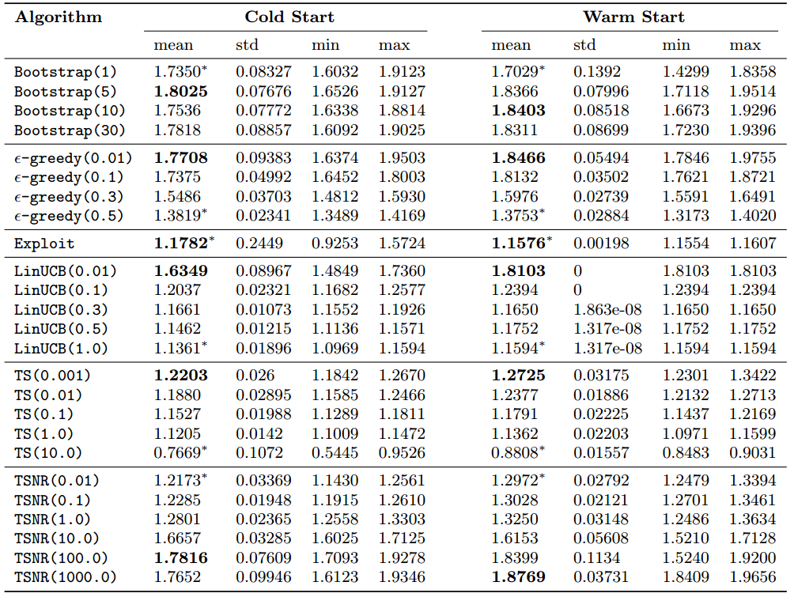
Experiment(Yahoo! News Data)
All numbers are relative to the random model.
Notes:
Cold start is the situation that there is no training data at the beginning for every algorithm. Warm start is the situation that there are 10,000 impression data as the initial training.
The best performance is highlighted in bold while the worst mean is marked with an asterisk.
Here are the interesting results:
First, є-greedy, LinUCB and the variant of Thompson sampling can have both good performance and bad performance depending on the parameter setting.
Second, both prior mean and prior variance affect the performance of Thompson Sampling. 0 is not a good prior mean if the prior variance is too small.
The bootstrap based method is comparable with the best algorithms with best parameter settings.

Slide 83
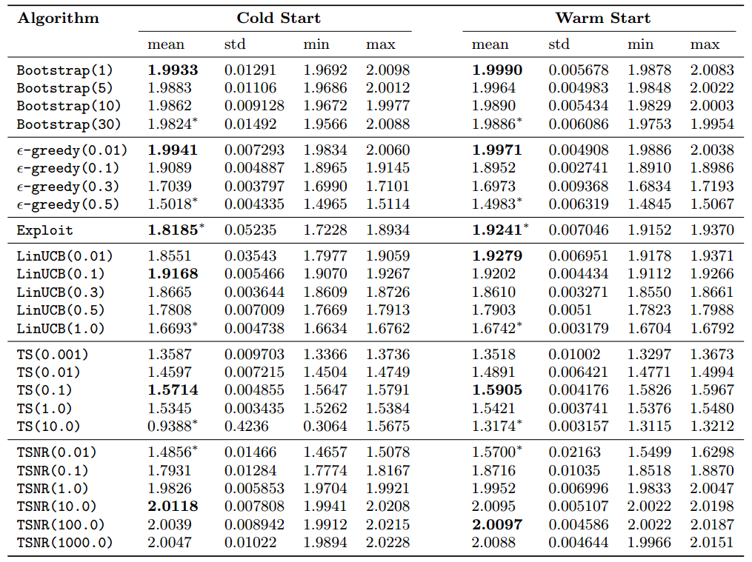
Experiment(AD KDD Cup’12)
All numbers are relative to the random model.
Notes:
This is the similar results from the KDD cup 2012 ad click prediction data.

Slide 84
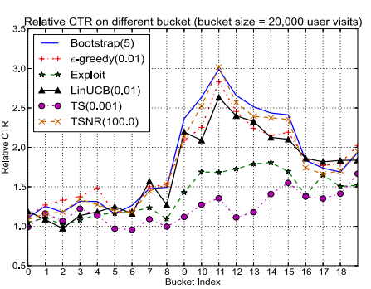
CTR over Time Bucket (Yahoo! News Data)
Notes:
We also split the data into different time bucket. Here is the CTR of different algorithms on different time bucket.
As you can see that, the bootstrap based method is almost always the top curve.

Slide 85

CTR over Time Buckets (KDD Cup Ads Data)
Notes:
Here is the similar result on the KDD cup 2012 Ad data.
Note that, for this data’s experiment, the click is simulated by a trained logistic regression model. This model does not consider the time features, so the CTR of all methods are stable over different time buckets.

Slide 86

Efficiency
Time cost on different bootstrap sample sizes
Notes:
For bootstrapping, usually more bootstrap samples can have higher approximation of the distribution of estimated coefficients. But more bootstrap samples need more computation for each recommendation. This figure shows the average time cost for each recommendation by varying the number of bootstrap samples.

Slide 87
Summary of Experiment
Summary
For solving the contextual bandit problem, the algorithms of є-greedy and LinUCB can achieve the optimal performance, but the input parameters that control the exploration need to be tuned carefully.
The probability matching strategies highly depend on the selection of the prior.
Our proposed algorithm is a safe choice of building predictive models for contextual bandit problems under the scenario of cold-start.
Notes:
For solving the contextual bandit problem, the algorithms of є-greedy and LinUCB can achieve the optimal performance, but the input parameters that control the exploration need to be tuned carefully.
The probability matching strategies highly depend on the selection of the prior.
Our proposed algorithm is a safe choice of building predictive models for contextual bandit problems under the scenario of cold-start.

Slide 88
Conclusion
Propose a non-Bayesian Thompson Sampling method to solve the personalized recommendation problem.
Give both theoretical and empirical analysis to show that the performance of Thompson sampling depends on the choice of the prior.
Conduct extensive experiments on real data sets to demonstrate the efficacy of the proposed method and other contextual bandit algorithms.

Slide 89
Future Work
MAB with similarity information
MAB in a changing environment
Explore-exploit tradeoff in mechanism design
Explore-exploit learning with limited resources
Risk vs. reward tradeoff in MAB
[1] http://research.microsoft.com/en-us/projects/bandits/

Slide 90
Question and Answer
Thanks!

